Slide 2
“A New Alternative to Delivering Justice… How YOU Can Be Involved!”

Slide 3
What is a Teen Court?
Teen court is a general term describing courts that involve young people in the sentencing of their peers, whether in a school, juvenile justice, or a community setting.

Slide 4
What is a Teen Court?
Working Together for Youth in West Virginia
A diversion program, offered as an alternative to the regular juvenile justice process
Youth are required to admit responsibility for their offense in order to qualify for teen court
Young offenders going through teen court agree to abide by whatever sanctions they are given
Sanctions vary depending on type of offense and penalties imposed by judge/jury

Slide 5
What is a Teen Court?
Working Together for Youth in West Virginia
Usually have young people serving as:
Jurors
Prosecuting Attorney
Defense Attorney
Bailiff
Clerk

Slide 6
What is a Teen Court?
Working Together for Youth in West Virginia
Offenders: 10-18 years old
Volunteers: 13-18 years old
Adult Volunteers: 18+ years old

Slide 7
What makes Teen Courts appealing?
Working Together for Youth in West Virginia
Teen Courts take advantage of one of the most powerful forces in the life of an adolescent…
(Positive) Peer Pressure!

Slide 8
What makes Teen Courts appealing?
Working Together for Youth in West Virginia
Serves as a prevention and early intervention program
Provides another option on the continuum of services currently offered
Offers a way to hold juvenile offenders accountable
Provides a means for educating youth on the legal and judicial system/Builds competencies
Supplies a meaningful forum for youth to practice and enhance skills
Offers an avenue for building ties between youth and their community

Slide 9
What makes Teen Courts appealing?
Working Together for Youth in West Virginia
Benefits go far beyond the defendants.
Four potential benefits are…
Accountability
Timeliness
Cost Savings
Community Cohesion

Slide 10
What makes Teen Courts appealing?
Working Together for Youth in West Virginia
ACCOUNTABILITY
Teen Courts may help to ensure that young offenders are held accountable for their illegal behavior, even when their offenses are relatively minor and would not likely result in sanctions from the traditional juvenile justice system.

Slide 11
What makes Teen Courts appealing?
Working Together for Youth in West Virginia
TIMELINESS
An effective Teen Court can move young offenders from arrest to sanctions within a matter of days rather than the months that may pass with traditional juvenile courts. This rapid response may increase the positive impact of court sanctions, regardless of their severity.

Slide 12
What makes Teen Courts appealing?
Working Together for Youth in West Virginia
COST SAVINGS
Teen Courts usually depend heavily on youth and adult volunteers. If manages properly, they may handle a substantial number of offenders at relatively little cost to the community.

Slide 13
What makes Teen Courts appealing?
Working Together for Youth in West Virginia
COMMUNITY COHESION
A well structured and expensive Teen Court program may affect the entire community by increasing public appreciation of the legal system, enhancing community-court relationships, encouraging greater respect for the law among youth, and promoting volunteerism among both adults and youth.

Slide 14
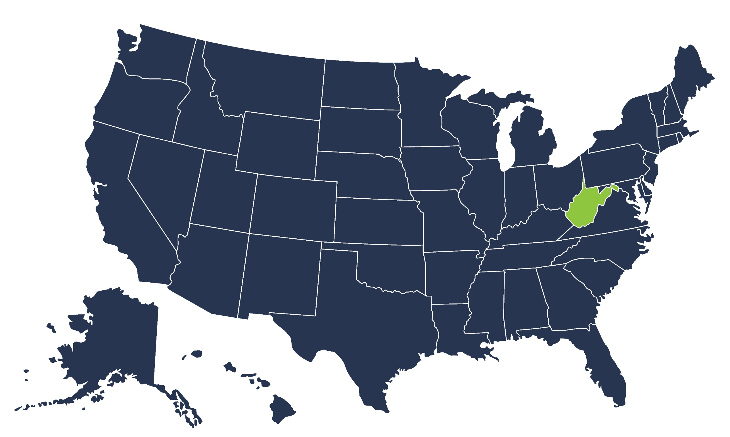
States with Teen Court Programs
Working Together for Youth in West Virginia

Slide 15
Who administers Teen Courts?
Working Together for Youth in West Virginia

Slide 16
Common Sentencing Options
Working Together for Youth in West Virginia
Teen Court Basic Training
Apology (written, oral, or both)
Community Service
Research Paper
Prevention or Education Program
Restitution
Other
Notes:
Community service 98%
Jury duty: 76% (required 60% or programs always require it) (10% say most of the time it is required)
Restitution: 59%
Essays: 88%
Oral/Written Apologies: 92%
Educational Workshops: 74%
VOM: 29%
Peer Mediation: 26%
Victim Awareness Classes: 29%
Alcohol/Drug Assessment: 56%
Drug Testing: 29%
Curfew: 42%
Tutoring: 34%
Counseling: 8%
Jail Tour: 5%
Suspend Drivers' License: 1.8%
Mentoring: 1.2%
Use of sentencing guidelines: Yes: 94%, No: 6%

Slide 17
Additional Sentencing Options
Working Together for Youth in West Virginia
Alcohol - Drug Assessment
Curfew
Tutoring
Peer Mediation

Slide 18
Common Offenses Nationwide
Working Together for Youth in West Virginia
Weapon Possession or Use
Traffic Violation
Disorderly Conduct
School Disciplinary Problems
Trespassing
Marijuana Possession or Use
Truancy
Vandalism
Alcohol Possession or Use
Theft (including shoplifting)
Minor Assault

Slide 19
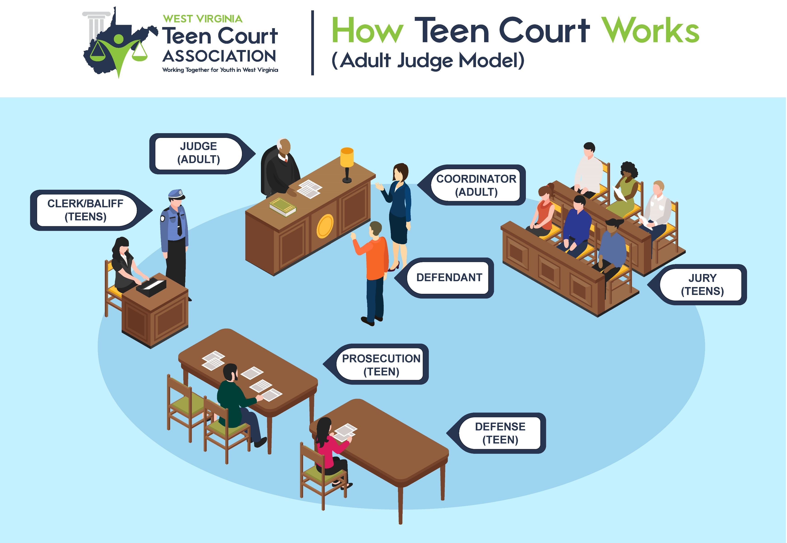

Slide 21
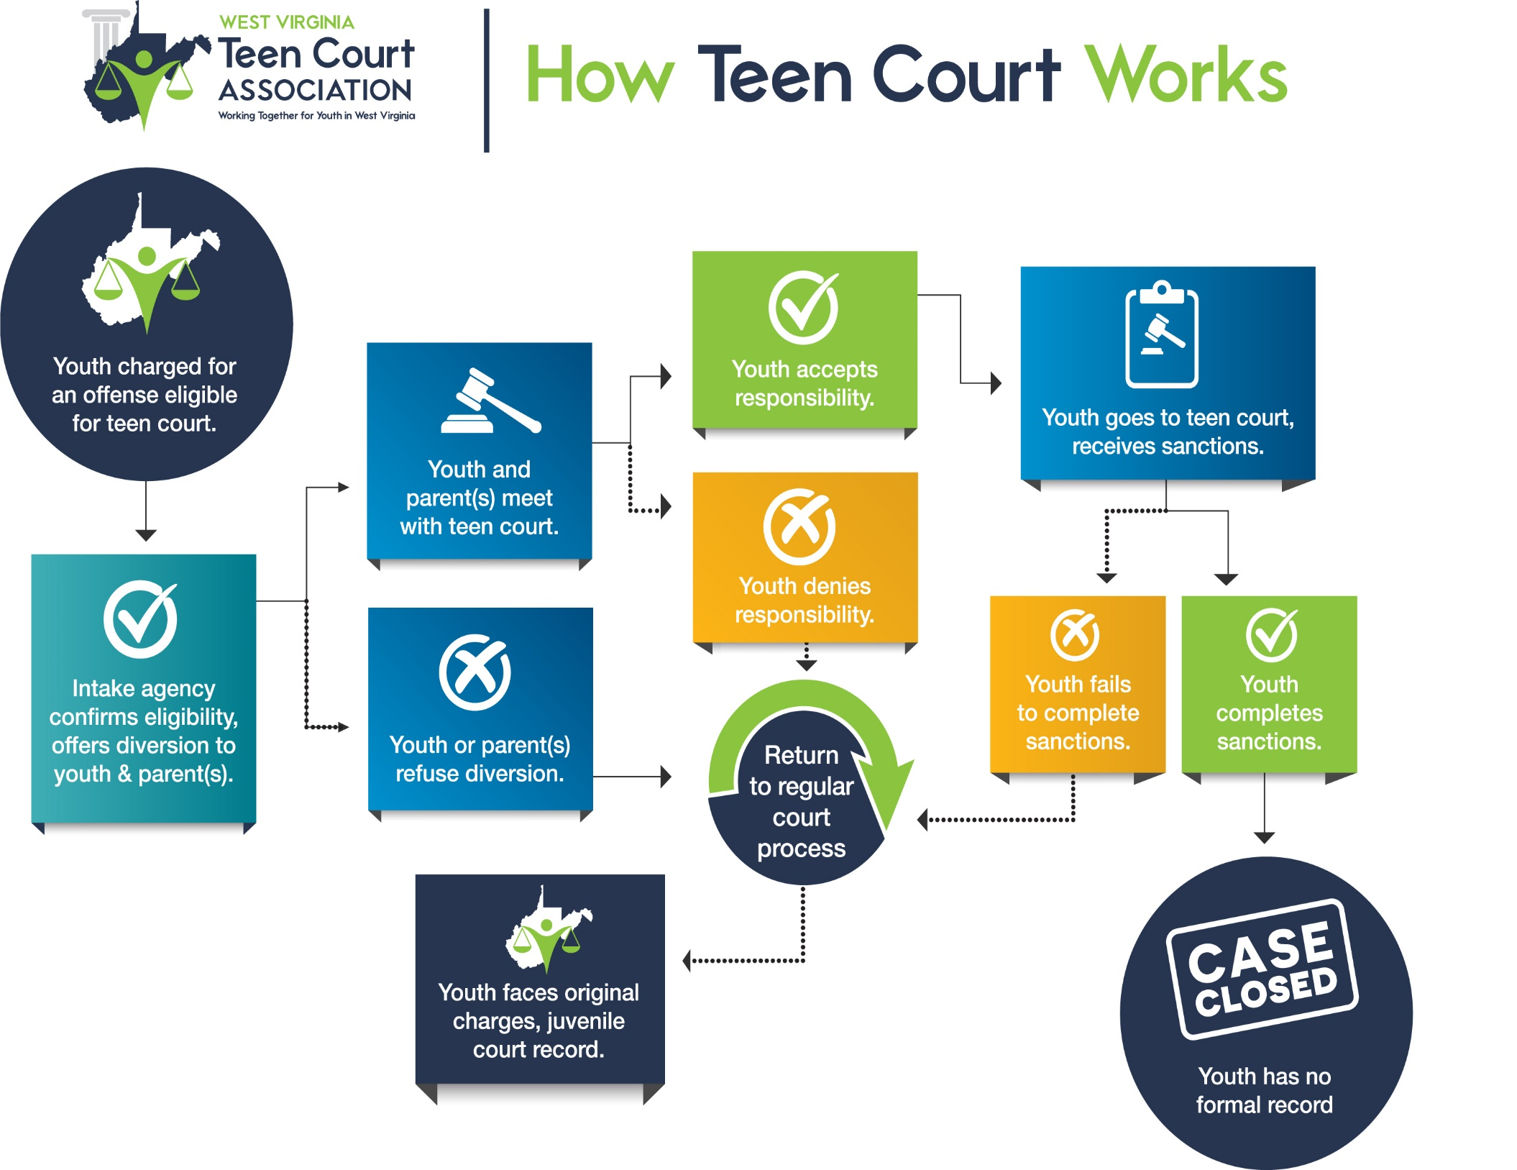
The teen court process varies from place to place, but it typically looks something like this...

Slide 23
QUESTIONS?

Slide 24
West Virginia Statute
Working Together for Youth in West Virginia
Be it enacted by the Legislature of West Virginia:
That §49-5-13d of the Code of West Virginia, 1931, as amended, be amended and reenacted to read as follows:
ARTICLE 5. JUVENILE PROCEEDINGS.
§49-5-13d. Teen court program.
Notwithstanding any provision of this article to the contrary, in any county that chooses to institute a teen court program in accordance with the provisions of this section, any juvenile who is alleged to have committed a status offense or an act of delinquency which would be a misdemeanor if committed by an adult and who is otherwise subject to the provisions of this article may be given the option of proceeding in the teen court program as an alternative to the filing of a formal petition under section seven of this article or proceeding to a disposition as provided by section eleven-a or thirteen of this article, as the case may be. The decision to extend the option to enter the teen court program as an alternative procedure shall be made by the circuit court if the court finds that the offender is a suitable candidate for the program. No juvenile may enter the teen court program unless he or she and his or her parent or guardian consent. Any juvenile who does not successfully cooperate in and complete the teen court program and any disposition imposed therein shall be returned to the circuit court for further disposition as provided by section eleven-a or thirteen of this article, as the case may be.
(continued…)

Slide 25
West Virginia Statute
Working Together for Youth in West Virginia
(B) The following provisions apply to all teen court programs:
(1) The judge for each teen court proceeding shall be an acting or retired circuit court judge or an active member of the West Virginia State Bar, who serves on a voluntary basis.
(2) Any juvenile who selects the teen court program as an alternative disposition shall agree to serve thereafter on at least two occasions as a teen court juror.
(3) Volunteer students from grades seven through twelve of the schools within the county shall be selected to serve as defense attorney, prosecuting attorney, court clerk, bailiff and jurors for each proceeding.
(4) Disposition in a teen court proceeding shall consist of requiring the juvenile to perform sixteen to forty hours of community service, the duration and type of which shall be determined by the teen court jury from a standard list of available community service programs provided by the county juvenile probation system and a standard list of alternative consequences that are consistent with the purposes of this article. The performance of the juvenile shall be monitored by the county juvenile probation system. The juvenile shall also perform at least two sessions of teen court jury service and, if considered appropriate by the circuit court judge, participate in an education program. Nothing in this section may be construed so as to deny availability of the services provided under section eleven-a of this article to juveniles who are otherwise eligible therefore.

Slide 26
West Virginia Statute
Working Together for Youth in West Virginia
(c) The rules for administration, procedure and admission of evidence shall be determined by the chief circuit judge, but in no case may the court require a juvenile to admit the allegation against him or her as a prerequisite to participation in the teen court program. A copy of these rules shall be provided to every teen court participant.
(d) Each county that operates, or wishes to operate, a teen court program as provided in this section is hereby authorized to adopt a mandatory fee of up to five dollars to be assessed as provided in this subsection. Municipal courts may assess a fee pursuant to the provisions of this section upon authorization by the city council of said municipality. Assessments collected by the clerk of the court pursuant to this subsection shall be deposited into an account specifically for the operation and administration of a teen court program. The clerk of the court of conviction shall collect the fees established in this subsection and shall remit the fees to the teen court program.
Any mandatory fee established by a county commission or city council in accordance with the provisions of this subsection shall be paid by the defendant on a judgment of guilty or a plea of nolo contendere for each violation committed in the county or municipality of any felony, misdemeanor or any local ordinance, including traffic violations and moving violations but excluding municipal parking ordinances.

Slide 27
Mission of the State Association
Working Together for Youth in West Virginia
The West Virginia Teen Court Association was established in early 2006 for the purposes of:
Providing continuing education and training for those operating Teen Courts
Maintaining a communication network between existing Teen Courts to develop consistency between programs
Promoting the development of other Teen Courts
Reducing juvenile crime

Slide 28
Contact Us
Working Together for Youth in West Virginia
Gregory A. Puckett
Executive Director
Community Connections, Inc.
215 South Walker Street
Princeton, WV 24740
drugfree@strongcommunities.org
(304) 913-4956

Slide 29
Working together for Youth Across West Virginia

